Slide 1
CS-701 Theory of Automata-II
Topic: Intro and Regular Languages

Slide 2
Course contents in brief
Theory of Automata
Finite State Models: Language definitions preliminaries
Regular expressions/Regular languages,
Finite automata (FAs), Transition graphs (TGs), NFAs,
kleene’s theorem, Transducers (automata with output),
Pumping lemma and non regular language Grammars and PDA
Context free grammars, Derivations, derivation trees and ambiguity, Simplifying CFLs,
Normal form grammars and parsing, Push-down Automata,
Pumping lemma and non-context free languages, Decidability,
Chomsky’s hierarchy of grammars
Turing Machines Theory: Turing machines, Post machine, Variations on TM, TM encoding, Universal Turing Machine
Context sensitive Grammars, Defining Computers by TMs.

Slide 3
Purpose of Course
Theory of Automata
In this Course our concern is not with actual hardware and software.
More interested in capability of computers.
specifically, what can and what cannot be done by any existing computer or any computer ever built in the future.
We will study different types of theoretical machines that are mathematical models for actual physical processes.

Slide 4
Cont….
Theory of Automata
By considering the possible inputs on which these machines can work,we can analyze their various strengths and weaknesses.
We can then develop what we may believe to be the most powerful machine possible.
Surprisingly, it will not be able to perform every task.

Slide 5
Cont….
Theory of Automata
In particular, the way we shall be studying about computers is to build mathematical models, called machines, and then to study their limitations by analyzing the types of inputs on which they can operate successfully.
The collection of these successful inputs is called the language of the machine

Slide 6
Cont….
Theory of Automata
Every time we introduce a new machine, we will learn its language; and every time we develop a new language, we will try to find a machine that corresponds to it.
We will study different types of theoretical machines that are mathematical models for actual physical processes. By considering the possible inputs on which these machines can work, we can analyze their various strengths and weaknesses.

Slide 7
Recommended Books
Theory of Automata
Introduction to Computer Theory, Denial Cohen, John Wiley & Sons, Inc.
Theory of Automata By C.J. Martin
Introduction to Automata Theory, Languages & Computation, J Hopcraft, D. Ullman
Languages & Machines, An Into to the Theory of Computer Science, 2/e Thomas A. Sudkamp, Addison Wesley.

Slide 8
Theory of Automata
Chapter 1: Introduction to Theory of Automata and Regular Expressions

Slide 9
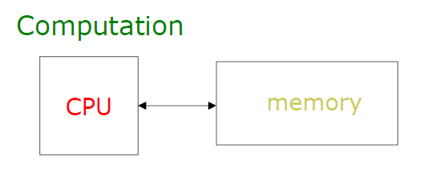
What Does Automata Mean?
Theory of Automata

Slide 10
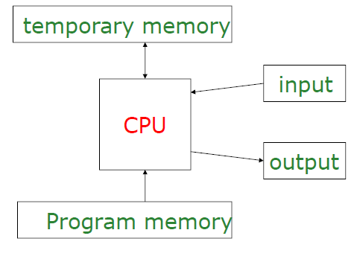
What Does Automata Mean?
Theory of Automata

Slide 11
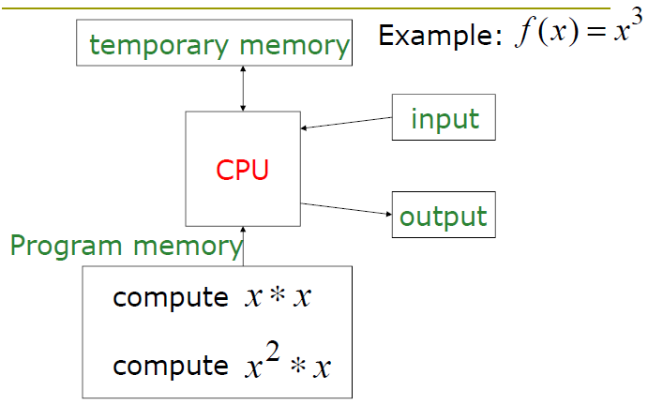
What Does Automata Mean?
Theory of Automata

Slide 12
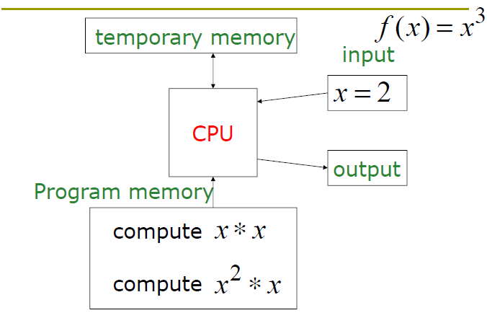
What Does Automata Mean?
Theory of Automata

Slide 13
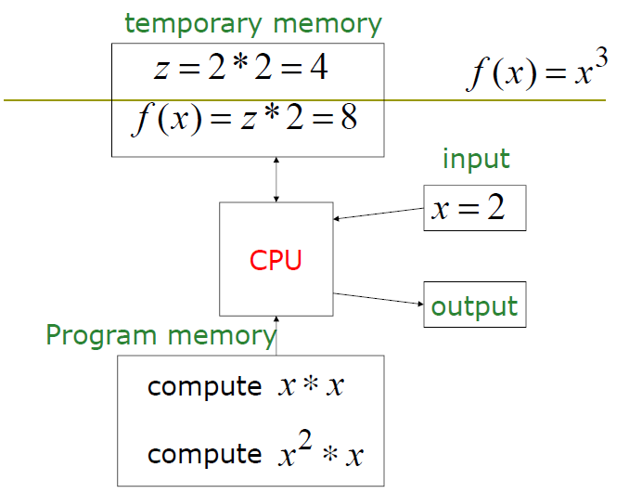
Theory of Automata

Slide 14
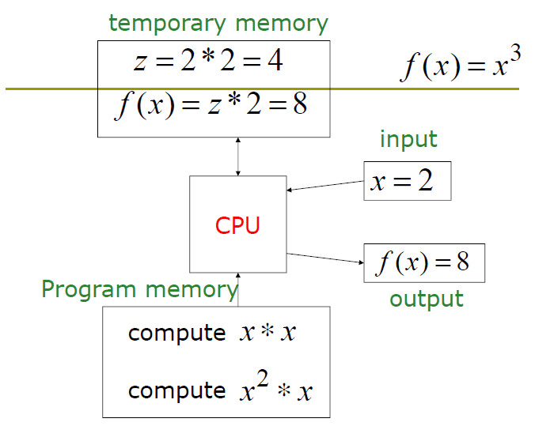
Theory of Automata

Slide 15
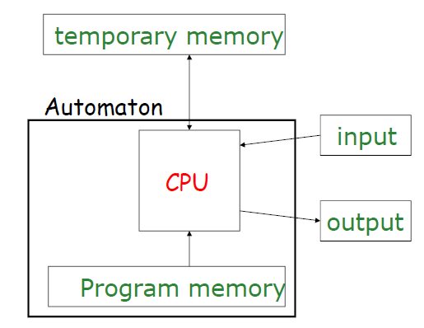
What Does Automata Mean?
Theory of Automata

Slide 16
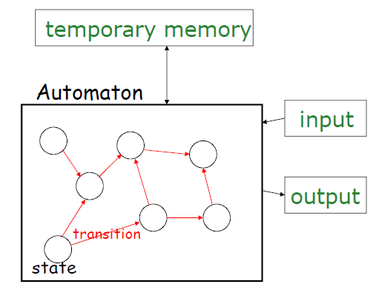
What Does Automata Mean?
Theory of Automata

Slide 17
What does automata mean?
Theory of Automata
Automata is Greek letters .Automata is a word formulated from automation, which means machine designing or replacing human beings with machines
It is the plural of automaton, and it means “something that works automatically”.

Slide 18
Different Kinds of Automata
Theory of Automata
Automata are distinguished by the temporary memory
Finite Automata: no temporary memory
Pushdown Automata: stack
Turing Machines: random access memory

Slide 19
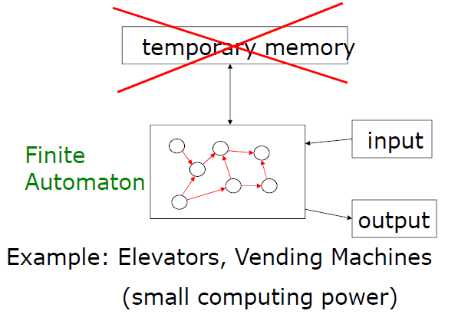
Finite Automaton
Theory of Automata

Slide 20
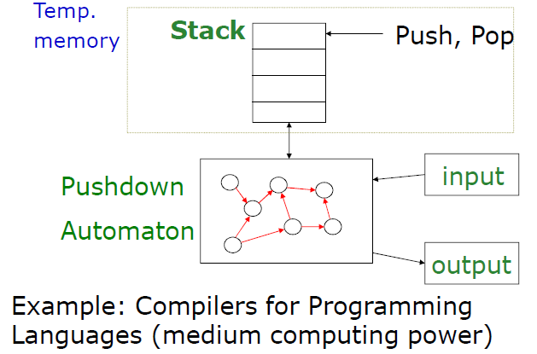
Pushdown Automaton
Theory of Automata

Slide 21
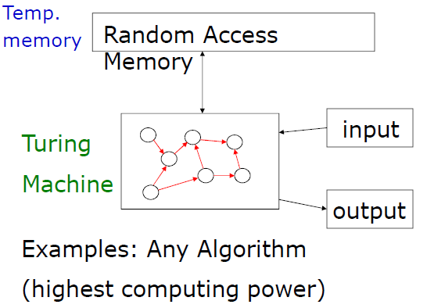
Turing Machine
Theory of Automata

Slide 22
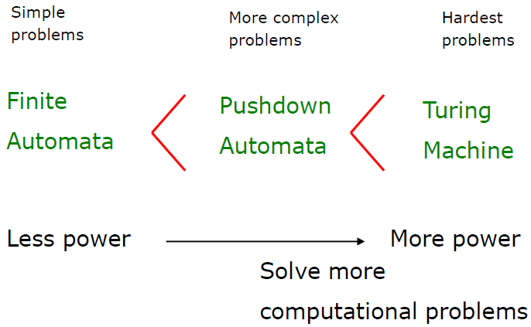
Power of Automata
Theory of Automata

Slide 23
Languages
Theory of Automata
Letters, Words, Sentences
Alphabets join to form words
Words combine to form sentences
Sentences combine to form paragraphs and so on
But the matter of fact is not all collections of letters form a valid word and not all collection of words form a valid sentence.

Slide 24
Languages
Theory of Automata
How can you tell whether a given sentence belongs to a particular languages
Black is cat the
The tea is hot
I like chocolates two much
Rules give a clue to forming as well as validating sentences.
There are two types of languages:
Formal Languages (Syntactic Languages)
Informal Languages (Semantic Languages)

Slide 25
Languages
Semantics ~ Meaning Syntax ~ Symbolic representation So two programs written in different languages could do the same thing (semantics) but the symbols used to write the program would be different (syntax). A compiler will check your syntax for you (compile-time errors), and derive the semantics from the language rules (mapping the syntax to machine instructions say), but won't find all the semantic errors (run-time errors, e.g. calculating the wrong result because the code says add 1 instead of add 2). Lexical level: how characters are combined to produce language elements ( i and f produces if) syntactical level: how language elements are combined to produce language expressions ( if, (, 42, ==, answer and ) produces a conditional statement) semantic level: how language expressions are converted to CPU instructions in order to form a meaning (a conditional statement allows to execute one branch or the other depending on the result of the Boolean expression)

Slide 26
Formal vs. Informal Rules
Theory of Automata
Informal language -> abstract languages
Incoherent (Disjointed, Confused, illogical) strings are understandable
Slang, idiom, dialect etc.
But Raise ambiguity
Interpretation varies with region
I am through (BrE/AmE)
Same words have multiple meanings.
Like, light, base, etc.

Slide 27
Informal languages
Theory of Automata
Natural languages are generally defined informally
Human brain are capable to understand incoherent even invalid sentences.
You mangoes like
We school daily go to
Rectify grammatical errors etc.
Resolve ambiguity
Interpret according to context
Supporting aids such as Facial expressions and body language etc.

Slide 28
How to Communicate with machines ?
Theory of Automata
Need a language: what sort
Machines don’t have human mind though may have its partial imitation
Would fail on incorrect or ambiguous input
Some recovery or input corrections may be proposed but again very limited.
Thus need a precise, explicit(clear , unambigous) and universal definition of communication language

Slide 29
Summary of Languages
Theory of Automata
Three aspects/specifications
Lexical
Defines valid words/units of a language
Syntactic
Defines rules for combining the units to form valid sentences (computer programs in context of machines)
Semantic
Concerned with the interpretation or meaning of a sentence (what output to produce in context of machines)
Affected by ambiguity the most.

Slide 30
Formal Languages
Theory of Automata
Word “formal” refers to the fact that all the rules for the language are explicitly stated in terms of what string of symbols can occur
No ambiguities
Universally uniform understanding
Let the machine
Interpret an input uniformly every time. i.e. always produces same output for a particular input
Avoid crashes because of ambiguity
Explicitly reject invalid input

Slide 31
Formal Languages
Theory of Automata
Need precise uniformly understandable notation
Representations
Alphabet
Represents a finite set of fundamental units of lanauges, e.g. for English ∑={a,b,….z.A,…Z,}
Denoted by Σ
∑ = {0,1}
∑ = {0,1,2,3,4,5,6,7,8,9}
A certain specified set of strings of characters from the alphabet is called the language (set of words)

Slide 32
Formal Languages
Theory of Automata
List of words
Set of all valid words of a given language, e.g., a language English_Words that contains all valid words of English would have a  = {all entries of the dictionary + punctuation marks and blank space}
Denoted by 
Is  Finite or Infinite set.
Strings:
Concatenation of finite symbols from the alphabets is called a string.
A string a finite sequence of symbols chosen from alphabet.
Example: if Σ ={a,b} then a, abab, aaab, ababababa….

Slide 33
Formal Languages
Theory of Automata
Empty String or Null String
Empty String is a string which does not contain any letter. It is same as the empty set.
It is denoted by capital Greek letter lambda Λ.
Words
In spoken languages not all strings are words.
Example: in English if we combine abcd, it does not form any word.
Words are strings belonging to some language.
Example: if Σ={x} then a language L can be defined as, L={xn: n=1,2,3…} OR L={x, xx, xxx, xxxx…..} Here x, xx, xxx…. are the words of L.
Note: Not all strings are words but all words are strings

Slide 34
Formal Languages
Theory of Automata
Valid/In-valid Alphabets
While defining an alphabets, an alphabet may contain letters consisting of group of symbols, e.g., consider 2 alphabets: Σ1={B, aB, bab, d} and Σ2={B, Ba, bab, d} and a string BababB
This string may be tokenized in two different ways:
(Ba), (bab), (B)
(B), (abab), (B)
Which shows that the 2nd group can not be identified as a string, defined over Σ= {a,b}

Slide 35
Formal Languages
Theory of Automata
Note
While defining an alphabet of letters consisting of more than one symbols, no letter should be started with the letter of the same alphabet i.e. one letter should not be the prefix of another. However, a letter may be ended in the letter of same alphabet i.e. one letter may be the suffix of another.
Therefore, Σ1 is a valid alphabet and Σ2 is in-valid alphabet.

Slide 36
Formal Languages
Theory of Automata
String Variable:
A letter used for denoting a string. The author uses w, x, y and z as string variable. For example
w = 0111100 , x = 123045, z = abbbcdeg
String Length:
The number of positions for symbols in the string. For simplicity we can say that it is the number of symbols in the string. For example
|w| = 7 , |x| = ? , |z| = ?

Slide 37
Formal Languages
Theory of Automata
Reverse of a string
The reverse of a string s, denoted by rev(s), is obtained by writing the letters of s in reverse order.
Example 1: if s=abc is a string defined over Σ={a,b,c} then Rev(s)= cba
Example 2: if s=BaBbabBd is a string defined over Σ={B,aB,bab,d} then Rev(s)= dBbabaBB

Slide 38
Defining Languages
Theory of Automata
The language can be defined in different ways, such as
Descriptive definition
Recursive definition
Using Regular expressions (RE) and
Using Finite automaton (FA) etc.

Slide 39
Defining Languages
Theory of Automata
Define alphabet set
Define rules for forming valid words and sequences of words from ∑
Called grammar
Can be descriptive
Limitations of informalism
Can be mathematical
Can also define supporting functions e.g., length(X), reverse(x)

Slide 40
Defining languages
Theory of Automata
Example ∑={a,b,…z}
L = {all words formed only of odd number of xs}
L = {x^{n} | n is odd}
L = {all words of length less than or equal to 4}
PALINDROME ={Λ, all strings x such that reverse (x) = x}

Slide 41
Finite vs. Infinite Languages
Theory of Automata
Finite Languages
Countable set of words
Can be defined by rigorously listing the words in 
E.g. English_Words
Infinite Languages
Infinite set of valid words
Cant be listed completely
E.g. English_Sentences

Slide 42
Infinite Languages
Theory of Automata
Most of the languages are infinite
How can u check whether a word belongs to a language if it is
Finite
Checking its entry in 
Infinite
Validating against rules

Slide 43
Defining Language
Theory of Automata
Define alphabet set
Define rules for forming valid words and sequences of words from Σ
This is called grammar
Can be descriptive
Limitations of informalism
Can be mathematical
Can also define supporting functions e.g., length(X), reverse(x)

Slide 44
Defining Languages
Theory of Automata
Language defining rules can be of two kinds;
They can either tell us how to test a string of alphabet letters that we might be presented with, to see if it is a valid word or
They can tell us how to construct all the words in the language by some clear procedures (discussed later)

Slide 45
Defining Languages
Theory of Automata
Example
Lets discuss a simple example of language, if we start with an alphabet having only one letter, the letter x
Σ = {x}
We can define a language by saying any nonempty string of alphabet characters
L = {x xx xxx xxxx …}
L = {x^n for n =1, 2, 3, …}
Because of the way we have defined it, this language does not include the null string (Λ)

Slide 46
Defining Languages
Theory of Automata
We can define the operation of concatenation
x^{n} concatenated x^{m} is the new word x^{n+m}
We can define a language that contain Λ
L = {Λ, x, xx, xxx, xxxx}
= {x^{n} for n = 0, 1, 2, 3, …}
Here x⁰ = Λ and not x⁰ =1

Slide 47
Defining Languages
Theory of Automata
The language can be defined in different ways, such as
Descriptive definition
Recursive definition
Using Regular expressions (RE) and
Using Finite automaton (FA) etc.

Slide 48
Defining Languages
Theory of Automata
Descriptive definition
The language is defined, describing the conditions imposed on its words.
Example 1: the language L of strings of odd length, defined over Σ={a} can be written as L={a,aaa,aaaaa, …}
Example 2: the language L of strings that does not start with a, defined over Σ={a,b,c} can be written as L={b,c,ba,bb,bc,ca,cb,cc,….}

Slide 49
Defining Languages
Theory of Automata
Example 3: the language L of strings of length 2, defined over Σ={0,1,2} can be written as L={00,01,02,10,11,12,20,21,22}
Example 4: the language L of strings ending in 0, defined over Σ={0,1} can be written as L={0,00,10,000,010,100,110,…}
Example 5: the language EQUAL, of strings with number of a’s equal to number of b’s, defined over Σ={a,b} can be written as L={Λ,ab,aabb,abab,baba,abba…}

Slide 50
Defining Languages
Theory of Automata
Example 6: the language EVEN-EVEN, of strings with even number of a’s and even number of b’s, defined over Σ={a,b} can be written as L={Λ, aa,bb,aaaa,aabb,abab,abba,baab,baba,bbaa,bbbb, …}
Example 7: the language INTEGER, of strings defined over Σ={-,0,1,2,3,4,5,6,7,8,9} can be written as INTEGER={…..,-2, -1, 0, 1, 2, …}
Example 8: the language EVEN, of strings defined over Σ={-,0,1,2,3,4,5,6,7,8,9} can be written as EVEN={…..,-4, -2, 0, 2, 4, …}

Slide 51
Defining Languages
Theory of Automata
Example 9: the language {a^{n}b^{n}}, of strings defined over Σ={a,b}, as {a^{n}b^{n} : n=1,2,3…}, can be written as {ab, aabb, aaabbb,…..}
Example 10: the language {a^{n}b^{n}a^{n}}, of strings defined over Σ={a,b}, as {a^{n}b^{n}a^{n} : n=1,2,3…}, can be written as {aba, aabbaa, aaabbbaaa,…..}
Example 11: the language PRIME, of strings defined over Σ={a}, as {a^{p} : p is prime}, can be written as {aa, aaa, aaaaa,…..}

Slide 52
Defining Languages
Theory of Automata
PALINDROME: the language consisting of Λ and the strings s defined over Σ such that Rev(s)=s.
Example Σ={a, b}, PALINDROME = {Λ, a, b, aa, bb, aaa, aba, bab, bbb, ….}

Slide 53
Kleene Closure
Theory of Automata
Kleene Closure (applied to Σ) called Set Closure
Given an alphabet Σ, we wish to define a language in which any string of letters from Σ is a word, even the null string.
This language is called the closure of the alphabet
Denoted by Σ*
Also called Kleene star

Slide 54
Kleene Closure
Theory of Automata
Examples
If Σ = {x} then
Σ* = {Λ, x, xx, xxx …}
If Σ = {0 1} then
Σ* = {Λ, 0, 1, 00, 01, 10, 11, 000, 001 …}
If Σ = {a b c} then
Σ* = {Λ, a, b, c, aa, ab, ac, ba, bb, bc, ca, cb, cc …}

Slide 55
Kleene Star
Theory of Automata
Kleene star is an operation that makes an infinite language of strings out of an alphabet
“infinite language” means, infinitely many words, each of finite length
We write words in the language in size order, we usually follow this method of sequencing a language
This ordering is called lexicographic order

Slide 56
PLUS Operation (+)
Theory of Automata
PLUS operator is same as Kleene star closure except that it does not generate null string, automatically.
Examples
If Σ = {0 1} then
Σ⁺= {0, 1, 00, 01, 10, 11, 000, 001 …}

Slide 57
∑^{* and} ∑⁺
Theory of Automata
∑* : The set of all strings over an alphabet ∑ and called Kleene Star Closure of alphabet. So we have
∑* = ∑⁰ U ∑¹ U ∑² U ∑³ U……………
∑⁺ : The set of all strings over an alphabet ∑ excluding empty string, ε, and called plus operation. So we have
∑⁺ = ∑¹ U ∑² U ∑³ U……………

Slide 58
Some observations
Theory of Automata
Λ represents an empty string (not alphabet thus not a part of ∑)
ε also represents the same
ε is not equivalent to ϕ
If ∑ = ϕ then
∑* = {Λ}
Is S* == (S*)* and so on

Slide 59
Recursive Language Definition
Theory of Automata
Recursion
When an entity is referred within its definition
Recursive functions
A function calls itself within its definition/body
Principles of recursion
Define a base case
For termination (in case of top down)
For starting point (in case of bottom up)
Define the recursive part in terms of base case

Slide 60
Recursive Language Definition
Theory of Automata
A recursive definition is characteristically a three steps process
First, we specify some basic objects in the set
Second, we give rules for constructing more objects in the set from the one we already know
Third, we declare that no objects except those constructed in this way are allowed in the set

Slide 61
Recursive Language Definition
Theory of Automata
Example 1
Language Even where Σ = {1,2, 3, 4………}
Informal definition
Language of all words x such that x is divisible by 2
Rule 1: 2 is in Even
Rule 2: If x is in Even, then so is x+2
Rule 3: The only elements in the set Even are those that can be produced from the two rules above

Slide 62
Recursive Language Definition
Theory of Automata
Example 2
Define a language Positive of all positive natural numbers
Rule 1: 1 is in Positive
Rule 2: If x and y are in Positive, then so are x+y, x*y and x/y
Rule 3: The only elements in the set Positive are those that can be produced from the two rules above

Slide 63
Recursive Language Definition
Theory of Automata
Example 3
Define the language a^{n}b^{n}}, n=1,2,3…, of strings defined over Σ = {a b}
Rule 1: ab is in a^{n}b^{n}
Rule 2: If x is in a^{n}b^{n} then aXb is in a^{n}b^{n}
Rule 3: No strings except those constructed in above, are allowed to be in a^{n}b^{n}.

Slide 64
Recursive Language Definition
Theory of Automata
Example 4
Define the language L, of strings ending in a, defined over Σ = {a b}
Rule 1: a is in L
Rule 2: If x is in L then s(x) is also is in L, where s belongs to Σ*
Rule 3: No strings except those constructed in above, are allowed to be in L.

Slide 65
Regular Expressions
Theory of Automata
We have discussed about a specific class of language called as regular language.
We will also see the machine way of looking at the regular language.
Means, given a regular language, we can always create a finite state of automata which is deterministic and nondeterministic that can accept all the words of a regular language.

Slide 66

Regular Expressions
Theory of Automata
One way of looking at the language is named as Regular Expressions.
Regular expressions are nothing but consists of atomic expressions and some specific operators that operate on those atomic expressions to build or generate all the words of a given language.

Slide 67
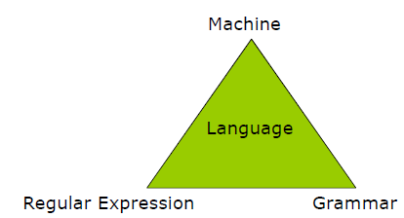
Regular Expressions
Theory of Automata
So the language can be viewed from three different ways.
Grammar is nothing but the set of rules.

Slide 68
Regular Expressions
Theory of Automata
As discussed earlier that a* generates Λ, a,aa,aaa,aaaa,aaaaa,… and a⁺ generates a,aa,aaa,aaaa,aaaaa,… so the language L1= {Λ, a,aa,aaa,aaaa,aaaaa, …} and L2= {a,aa,aaa,aaaa,aaaaa, …} can simply be expressed by a* and a⁺ respectively. a* and a⁺ are called Regular Expressions (RE) for L1 and L2 respectively.

Slide 69
Regular Expressions
Theory of Automata
With the small set of operators we build the entire regular expressions patterns.
a* means 0 or more occurrences of a
a⁺ means 1 or more occurrences of a
a? means 0 or 1 occurrence of a
[a-z] => a/b/c…z

Slide 70
Regular Expressions
Theory of Automata
The language can be defined by any of the expressions below:
xx*, x⁺, xx*x*, x⁺x* =>
ab*a =>
(ab)* =>
a*b* =>
a*b* in not equal to (ab)*
sign? (0/[1-9] digit*)

Slide 71
Regular Expressions
Theory of Automata
We now introduce another use of plus sign
x+y where x and y are string of characters from an alphabet we mean either “x” or “y”
Example 1:
Consider the language T defined over the alphabet Σ = {a b c}: T = {a c ab cb abb cbb abbb cbbb abbbb cbbbb…..}
All the words begin with an a or c and then are followed by some number of b’s, we may write this T = language((a+c)b*)

Slide 72
Regular Expressions
Theory of Automata
Example 2:
Consider a finite language L that contains all the strings of a’s and b’s of length three exactly: L = {aaa aab aba abb baa bab bba bbb}
The first letter of each word in L is either an a or a b, same is the case with the other 2 letters.
So we may write L = language((a+b)(a+b)(a+b))
L= language(a+b)³

Slide 73
Regular Expressions
Theory of Automata
If we want to define the set of all seven letter strings of a’s and b’s, we may could write
L= language(a+b)⁷
If we want to refer to the set of all possible strings of a’s and b’s of any length, we may could write
L= language(a+b)*
We can describe all the words that begin with the letter a
a(a+b)*

Slide 74
Regular Expressions
Theory of Automata
Similarly, we can describe all the words that begin with the letter a and end with letter b simply as
a(a+b)*b
Remove ambiguity altogether
Formal way to define the lexical specifications of a language

Slide 75
Regular Expressions
Theory of Automata
Called expressions on account of similarity with arithmetic expressions
Use *, + and ()
* shows repetition
+ presents choice or disjunction
() used for grouping

Slide 76
Regular Expressions
Theory of Automata
Given Σ = {a,b}
a* = {Λ, a,aa,aaa,aaa,aaaa,aaaaa, …}
ab* = {a, ab,abb,abbb,abbbb, …}
a+b = {a/b}
(ab)* = {Λ, ab, abab, ababab, …}
(a+b)* = {Λ, any string of a’s and b’s}

Slide 77
Regular Expressions
Theory of Automata
The symbols that appear in the regular expressions are;
the letters of the alphabet Σ,
the symbol for Λ,
Parentheses (),
the star operator *, and
the plus sign +

Slide 78
Regular Expressions
Theory of Automata
The set of regular expression is defined by following rules
Every letter of Σ and Λ is a regular expression
If r1 and r2 are regular expressions, then so are
(r1)
r1r2
r1+ r2
r1*
Nothing else is a regular expression

Slide 79
Regular Expressions
Theory of Automata
Whether following are REs? if so what languages do they generate?
bb(a+b)
(a+b)(a+b)(a+b)
(a+b)*ba
(a+b)*a(a+b)*
(a+b)*aa(a+b)*

Slide 80
Regular Expressions
Theory of Automata
Write RE for the following languages for Σ = {a, b}
All words ending with b
(a+b)*b
All words that start with a
a(a+b)*
All words that start with a double letter
(aa+bb)(a+b)*
All words that contain at least one double letter
(a+b)*(aa+bb)(a+b)*

Slide 81
Regular Expressions
Theory of Automata
Write RE for the following languages for Σ = {a, b}
All words that start and end with a double letter
(aa+bb)(a+b)*(aa+bb)
All words of length >=3
(a+b)(a+b)(a+b)(a+b)*
All words that contain exactly one a or exactly one b
b*ab* + a*ba*
All words that don’t end at ba
(a+b)*(aa+ab+bb)

Slide 82
Regular Expressions
Theory of Automata
Write RE for the following languages for Σ = {a, b}
Language of all words that have at least two as
(a+b)* a (a+b)* a (a+b)*
that have at least one a and at least one b
(a+b)* a (a+b)* b (a+b)*

Slide 83
Regular Expressions
Theory of Automata
Write RE for the languages L, of even length, defined over Σ = {a, b}
((a+b)(a+b))*
Write RE for the languages L, of odd length, defined over Σ = {a, b}
((a+b)(a+b))*(a+b)

Slide 84
Regular Expressions
Theory of Automata
EVEN-EVEN (Σ = {a, b})
Language of all words having even number of as and even number of bs
Partitions/sets
Even as even bs (valid)
Even as odd bs (need to adjust bs)
Odd as odd bs (need to adjust as and bs)
Odd as even bs (need to adjust as)

Slide 85
Regular Expressions
Theory of Automata
EVEN-EVEN (Σ = {a, b}) i.e. = {Λ, aa, bb, aaaa, aabb, abab, abba, baab, baba, bbaa, bbbb, …}
RE sets
(aa+bb)*
((ab+ba)(ab+ba))*
(aa + bb + (ab + ba )(aa + bb)* (ab + ba))*

Slide 86
Regular Expressions
Theory of Automata
Note:
If r1=(aa+bb) and r2=(a+b) then
r1+r2 = (aa+bb) + (a+b)
r1r2 = (aa+bb) (a+b) = (aaa + aab + bba + bbb)
r1* = (aa+bb)*
Two way relation is important in case of association of a RE with a language
All possible strings of a language can be generated from the RE
All strings generated by the RE should be part of the language

Slide 87
Regular Expressions
Theory of Automata
Equivalent Regular Expression: two regular expressions are said to be equivalent if they generate the same language.
Example
r1 = (a+b)*(aa+bb)
r2 = (a+b)*aa+(a+b)*bb
Both RE define the language of strings ending in aa or bb

Slide 88
Regular Expressions
Theory of Automata
The languages defined by a regular expression are called regular languages Or alternatively
Any language that can be represented by a regular expression is a regular language
It may be noted that a language may be expressed by more than 1 regular expression but given a RE there is a unique language generated by that RE.

Slide 89
Language (Set) operations
Theory of Automata
If L1 and L2 are two languages (set of words)
L1L2 is a product set that contain all combinations of a string from L1 concatenated with a string from L2
L1+L2 is the union set (equivalently L1 U L2) containing all words of L1 and L2
Examples
If S = {a aa aaa}, T = { bb bbb}
ST = {abb abbb aabb aabbb aaabb aaabbb}
S+T = {a aa aaa bb bbb}
If S = {a bb bab}, T = { a ab}

Slide 90
Languages Associated with REs
Theory of Automata
If r1 is a regular expression associated with the language L1 and r2 is a regular expression associated with the language L2, then
Language(r1r2) = L1L2
Language(r1+ r2) = L1+ L2 = L1 U L2
Language(r1*) = L1* (Kleen’s Closure of L1)

Slide 91
Regular Languages
Theory of Automata
How to tell whether a language is regular
Define a RE for it, if it is possible to define, the language is Regular otherwise non-regular
Must define a precise checking mechanism for RLs(to be discussed later)

Slide 92
Finite Languages are Regular
Theory of Automata
If L is a finite language (with only finitely many words), then L can be defined by a regular expression
All finite languages are regular
Example
Consider a language L1, defined over Σ = {a, b}, of strings of length 2, starting with a, then L={aa, ab}, may be expressed the RE aa+ab. Hence, L1 by definition, is a regular language.

